Slide 1
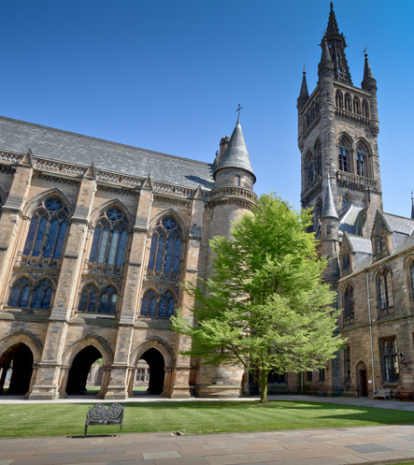
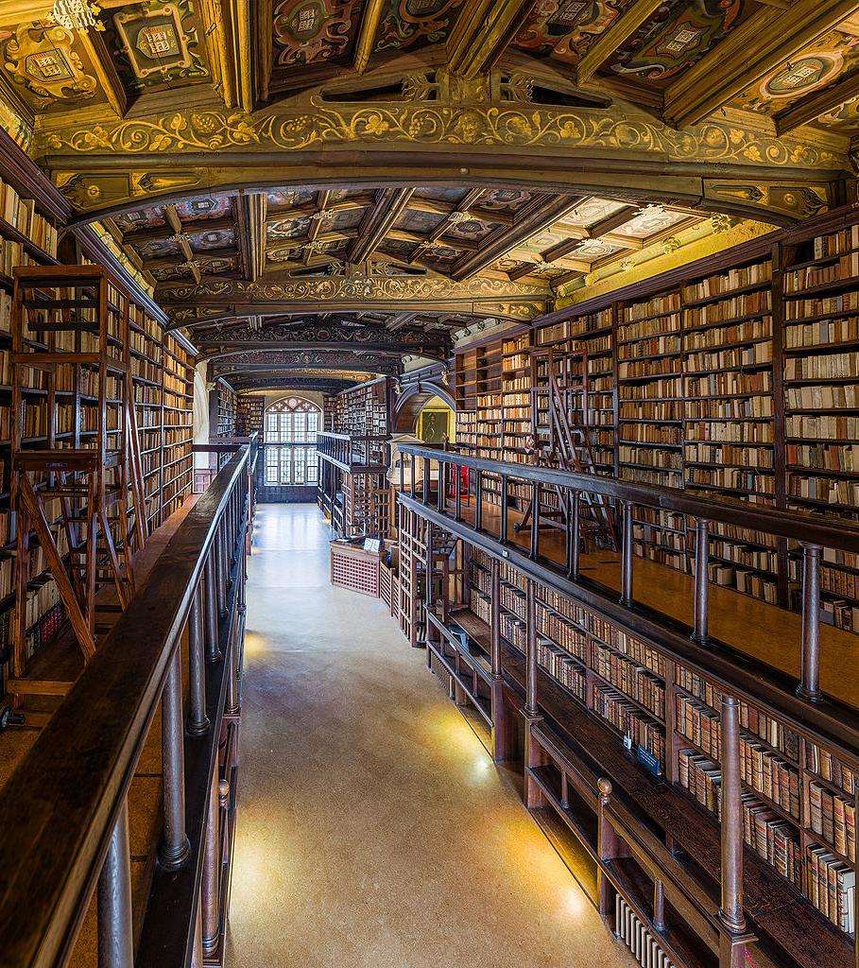
Digital library futures: the impact of e-legal deposit in the academic sector
LISRival Event 3: 19th March 2020
Paul Gooding (University of Glasgow) and Frankie Wilson (Bodleian Libraries, University of Oxford).
This Photo by Unknown Author is licensed under CC BY
This Photo by Unknown Author is licensed under CC BY-SA

Slide 2

User-Centric Evaluation of Non-Print Legal Deposit in the United Kingdom: the Digital Library Futures Approach
Paul Gooding (University of Glasgow); Melissa Terras (University of Edinburgh); Linda Berube (University of East Anglia);
@pmgooding / paul.gooding@glasgow.ac.uk

Slide 3
Talk Outline
Introduction:
  Overview of Digital Library Futures project;
  Intro to Non-Print Legal Deposit (NPLD) in the United Kingdom.
Project background:
  Accounting for access to NPLD;
  Defining impact and value in relation to NPLD.
Methodology.
Findings.
Conclusion: Towards User-Centric Evaluation of NPLD.
  What skills might this approach require?

Slide 4

Introduction

Slide 5
A Brief Definitional Aside
Legal Deposit – “the legal requirement that a person or group submit copies of their publications to a trusted repository or repositories.”
Electronic Legal Deposit: broad term to denote legal deposit regulations that apply to digital materials.
Non-Print Legal Deposit: the specific term for the UK’s e-legal deposit regulations.
The Legal Deposit Libraries (Non-Print Works) Regulations 2013 refer to work in writing – “(a) transmitted by electronic means; (b) received in legible form; and (c) capable of being used for subsequent reference” (2013).

Slide 6

The Digital Library Futures Project
Two year AHRC-funded project to investigate the impact of e-Legal Deposit on UK Academic Deposit libraries:
  Case study partners: Bodleian Libraries & Cambridge University Library.
Focus on academic deposit libraries:
  Shift focus away from national libraries and towards the specific problems faced within academic libraries.
First ever public user-centric study of the impact of e-legal deposit.
  Normally focused on technical, preservation, and long-term aspects of these collections, not contemporary usage.
Aim to address several challenges created by tension between user and publisher rights.

Slide 7

What is Legal Deposit?
Legal Deposit – “the legal requirement that a person or group submit copies of their publications to a trusted repository or repositories.”
Electronic Legal Deposit: broad term to denote legal deposit regulations that apply to digital materials.
Non-Print Legal Deposit: the specific term for the UK’s e-legal deposit regulations.
The Legal Deposit Libraries (Non-Print Works) Regulations 2013 refer to work in writing – “(a) transmitted by electronic means; (b) received in legible form; and (c) capable of being used for subsequent reference” (2013).
https://www.flickr.com/photos/pimthida/9438755028/

Slide 8
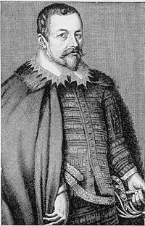

The Origins of UK Legal Deposit
1610: Informal agreement between Sir Thomas Bodley (founder of the Bodleian Library) and the Stationer’s Company:
  Bodleian could claim a copy of everything printed under Royal License.
1662: First legal framework for legal deposit in the UK – extended Royal License to Cambridge University Library.
1709/1710: Copyright Act under Queen Anne.
1753: Establishment of British Museum;
  Until this date the Bodleian Cambridge University Libraries were the de facto national libraries of the United Kingdom.
1911: Copyright Act.
1911-2013: Various minor changes, until…

Slide 9

“Non-Print Legal Deposit” in the United Kingdom
“Legal Deposit Libraries (Non-Print) Regulations 2013”:
  Bring electronic publications into line with printed materials, and cover:
    Websites;
    e-Journals;
    e-Books;
    Digital Newspapers;
    Digital Maps.
Users can access electronic materials within the six legal deposit libraries.
But what are the access protocols, and how does this affect data collection?
https://flic.kr/p/fgBmVV

Slide 10

Project Background

Slide 11
Access to NPLD Materials in the UK
1.) Reader access to NPLD materials is limited to computer terminals located on premises controlled by the legal deposit libraries (part 1, regulation 2).
2.) Materials must only be accessible concurrently to readers via one computer at each legal deposit library (part 4, regulation 23).
3.) For materials published online, seven days must elapse between the date of delivery of that material, and the date on which it is made available (part 4, regulation 24).
4.) A copyright owner may request in writing that certain materials should be embargoed for a specific period. Deposit libraries are bound to comply with such requests, provided that:
  The period for which materials are withheld is limited to three years from the date of the request;
  The deposit library is satisfied that, during the requested timeframe, viewing of the relevant materials by readers would, or would be likely to, “unreasonably prejudice the interests of the person making the request” (part 4, regulation 25).
5.) Deposit libraries are permitted to produce and allow access to copies of non-print work on their premises for a visually impaired person, if copies of the relevant material are not commercially available in an accessible form (part 4, regulation 26).

Slide 12
1.) NPLD in academic deposit libraries has been under-investigated
Focus to date upon “four pillars”:
  Collection development, including selection and metadata;
  Long-term digital preservation of NPLD materials;
  Aspects of technical implementation, including systems, capture, ingest, and standards;
  Regulatory aspects, including observations on the development of NPLD regulations.

Slide 13
2.) Very little data has been published on the users of NPLD collections.
Users have not been investigated with the same rigour as other aspects of NPLD.
Only two studies have focused on access to materials covered by e-legal deposit:
  Helen Hockx-Yu (2014) – scholarly use of the UK Web Archive;
    Found access problematic due to regulatory restrictions and the presence of a single use case.
  Georgi Alexandrov (2018) – outline of access to e-legal deposit across European nations.
    Use case for e-legal deposit termed “e-reading”.
    Predicted a move towards more liberal access in future.

Slide 14
User-Centric Evaluation of NPLD: Underlying Principles
Two overlapping ways of considering the impact of NPLD:
  “Value” – the benefits, or lack thereof, of NPLD for libraries and their users.
  “Impact” – the ways in which digital collections effect change in collecting, managing and information seeking behaviour.
We further define value in two ways:
  Intrinsic Value - the value something has in and of itself.
  Instrumental Value – the value something has because it helps us to achieve or get something.
User-Centric Evaluation positions this instrumental value within the tradition of service-based librarianship, grounded in making collections usable and meaningful to users.
The key debate explores interplay between undoubted intrinsic value of NPLD, and how it supports service-based librarianship.

Slide 15
Methodology

Slide 16
Interviews
Interviews undertaken with 36 expert stakeholders:
  Key figures at academic libraries; academics in related fields; publishing industry representatives; policymakers.
Semi-structured interviews, mapped to specific research questions and forming the basis for one hour interviews.
Qualitative coding adopted three level approach suggested by Hahn (2008):
  “initial coding” to develop categories and themes;
  “focused coding” to start grouping categories together;
  “axial coding” to refine ideas with a finer focus.

Slide 17
Surveys
Surveyed 80 users in total: 40 from Bodleian, 40 from Cambridge University Library:
  Heterogenous sample designed to ensure representation from a broad range of disciplines.
Deliberately delivered to small group of users to gather in-depth feedback linking information seeking behaviour to usage of NPLD.
Task-based: successful completion necessitated respondents to come into contact with NPLD materials.
Analysed in Excel and light thematic coding in Nvivo.

Slide 18
Web Analytics
1.) Web Log Analysis:
  Analysis of usage of NPLD terminals in the academic deposit libraries, to provide headline statistics of usage of relevant materials.
  Covered all six legal deposit libraries, but reporting was broken down into constituent libraries.
  Provided information on number of unique visits, basic engagement stats, and types of content being used.

Slide 19
Web Analytics
2.) Subject-based analysis:
  Based on Marcia Bates observation that scholarly communication practices differ across domains, and that “these differences do make a difference” (Bates, 1998)
  Two datasets (31st July 2015 to 31st March 2017):
    eBook title requests (91,809 requests at title level);
    eJournal requests (36,505 requests at article level.
  Subjectify used to automatically obtain DDC and LCC classmarks for each record – discarded unclassified records and subsequently analysed usage by subject.

Slide 20
Findings

Slide 21
NPLD has had a positive impact…
Insofar as the libraries “now have access to digital collections in unprecedented depth and breadth, and in increasingly varied formats” (Gooding et al., 2019):
  NPLD is the “gold standard”.
  One interviewee described the Web Archival materials as a “crown jewel that allowed new materials to be systematically collected.
NPLD has broad intrinsic value due to its perceived prestige, future benefits to researchers, and its role in preserving the published record of the United Kingdom.

Slide 22
But identifying the intrinsic value of NPLD is more complex
Library staff disappointed with access arrangements:
  Restricting access to reading rooms.
  Usage restrictions.
Pagination raised as a frequent issue:
  Seen as a broader challenge for libraries and scholars, but…
  Collections librarians noted that they were unable to choose NPLD formats, and that deposited works often didn’t meet user needs.
Feeling among interviewees that user requirements not fully considered in development and implementation.

Slide 23
Usage: Where is the Frame of Reference?

Slide 25
The ”Archetypal” Survey Respondent
Works remotely on a personal device, using commercial search engines or library databases to start their search, using some form of authentication to access subscription materials.
Often engaged in work away from the university, including international fieldwork.
Depending on discipline, is likely to work with a set group of electronic resources.
Uses web archives, including the UK Legal Deposit Web Archive, very little or not at all.
Sometimes visits central library sites in person, but more likely to use faculty, department, or subject libraries due to community and relevance.

Slide 26
But would they consider NPLD, given the choice?

Slide 27
NPLD Reflects Long-Established Disciplinary Usage (eBooks)

Slide 28
And eJournals

Slide 29
Conclusion

Slide 30
Drawing these together: Towards User-Centric Evaluation of NPLD
Undoubted enthusiasm of our interviewees for the potential of NPLD collections.
But even after six years there is no clear sense of the instrumental value of NPLD.
We draw upon the service-driven values of contemporary library practice to propose a model of user-centric evaluation that:
  Aims to make collections accessible and meaningful to researchers;
  Recognises the complex nature of rights in digital publishing;
  Is informed by longitudinal data collection and analysis.

Slide 31
User-Centric NPLD: The Five Key Tenets
1.) The long-term beneficiaries of NPLD are users, not publishers or libraries. It is therefore necessary to evaluate NPLD in comparison to broader user needs, even if those needs are not immediately addressed through short-term changes to access arrangements.
2.) The diversity of digital media reflect a major change in information sharing, society, libraries, and research communities, which necessitates re-evaluation of the assumption that print media remain the most useful reference point for defining access protocols.
3.) Publishers are entitled to protect their commercial and legitimate interests, and this remains a reason not to liberalise access without appropriate consultation.
4.) Libraries must be empowered to take actions to respond to emerging information behaviours, including those actions linked to large-scale digital preservation. These actions should be based on evidenced trends in user behaviour and needs, and focus upon making collections accessible, usable, and meaningful to users in the long term.
5.) The first four tenets require continued collaboration between libraries, publishers and user groups.

Slide 32
Finally: what does this mean for NPLD evaluation?
Need to address gap between existing models for impact evaluation and work on collections for which there is no identifiable community of users.
Essential to relate library evaluation not only to (e.g.) technical solutions and UX design, but also to understand how this work is situated in relation to broader information seeking behaviours.
Requires a “flexible and potentially experimental approach to research methodology” (Gooding et al., 2019, p.27) to uncover relationships in innovative ways.
Applied theory: broad engagement required to ensure relevance of theoretical and critical work to practical implementation of library digital resources.

Slide 33

Project Partners and Funding
This research was supported by a grant from the Arts and Humanities Research Council under grant number AH/POO5845 between June 2017 and May 2019.
Core research was carried out at the University of Glasgow, the University of Edinburgh, the University of East Anglia, and University College London. We are grateful to our project partners, Cambridge University Library and Bodleian Libraries, University of Oxford, and to the British Library, for their assistance and support.

Slide 34
References
Alexandrov, Georgi. “Transformation of Digital Legal Deposit in Terms of Legislation and Public Access.” Knygotyra 70 (2018): 136–53.
Gooding, Paul, Melissa Terras, and Linda Berube. “Towards User-Centric Evaluation of Non-Print Legal Deposit: A Digital Library Futures White Paper.” Glasgow, Edinburgh and Norwich: University of Glasgow, 2019. http://eprints.gla.ac.uk/186755/
Hahn, Christopher. Doing Qualitative Research Using Your Computer: A Practical Guide. London: Sage Publications Ltd, 2008.
Hockx-Yu, Helen. “Access and Scholarly Use of Web Archives.” Alexandria 25, no. 1/2 (2014): 113–27.
The Legal Deposit Libraries (Non-Print Works) Regulations 2013, Pub. L. No. SI 2013/777 (2013). http://www.legislation.gov.uk/uksi/2013/777/contents/made.

Slide 35
A brief interlude, and a quick task!
Please stand up, walk across the room and debate the following question with someone that you don’t yet know:
“Do you feel collaborations with academic researchers would support or get in the way of your own ongoing efforts to undertake assessment work?”

